Slide 1
JOB Tracking Application
PROJECT - 1
MADE BY – UDITYA SETH

Slide 2
Introduction
In today’s competitive job market, keeping track of multiple job applications can be a stressful and disorganized process. Many job seekers often face challenges such as:
Forgetting application deadlines
Losing track of companies or roles they've applied to
Missing follow-up opportunities
To address these issues, this project presents a Job Application Tracker built in Microsoft Excel, which simplifies the process of recording, organizing, and monitoring job applications.
With built-in features like filtering, conditional formatting, and visual dashboards, this tracker ensures that no opportunity slips through the cracks.
Objective
The main objective of the Job Application Tracker project is to:
📌 Centralize all job application information in one structured sheet
⏰ Track deadlines efficiently using visual cues like conditional formatting
📊 Monitor application statuses (Applied, Interviewed, Offered, Rejected)
🔍 Enable quick filtering by company, role, or current status
📈 Provide visual insights through dynamic charts (e.g., status distribution)
✅ Help job seekers stay organized, focused, and prepared throughout the job-hunting process

Slide 3
# PROCESS
1 I HAVE GENERATE DATA SET
THEN ACCORDING TO INSTRUCTIONS
I HAVE CLEAN IT
THEN I HAVE DONE A CONDITION FORMATING ACCAORDING TO DATE
THEN I HAVE APPLIED FILTERS IN ALL COLOUMNS EXCEPT DEADLINES
THEN I HAVE CREATED STAUS DISTRIBUTION PIE CHART ACCORDING TO MY DATA
THEN I HAVE USE A LINE CHART TO REPRESENT THE DEADLINE OF APPLICATION OF DIFFERENT COMPANY WITH RESPECTIVE JOB ROLES
THEN I HAVE USED CLUSTERED COLOUMN CHART TO SEE NUMBER OF APPICANT APPLIED FOR DIFFERENT COMPANY
THEN I AGAIN USE SAME CHART TO REPRESENT THE MONTHLY AND DAY WISE TREND
THEN I HAVE ADD NEW COLOUM TO MY DATA SET FOR FOLLOW UP REMINDER
THEN I HAVE MAKE A PIE CHART TO MAKE FOLLOWUP REMINDER ACCORDING TO MY DATASET
AT LAST I HAVE COMBINED ALL CHARTS AND CREATED FINAL DASHOARD WITH DIFFERENT SLICER SO THAT WE CAN SEE WORKING OF ALL CHARTS ACCORDINGLY

Slide 4
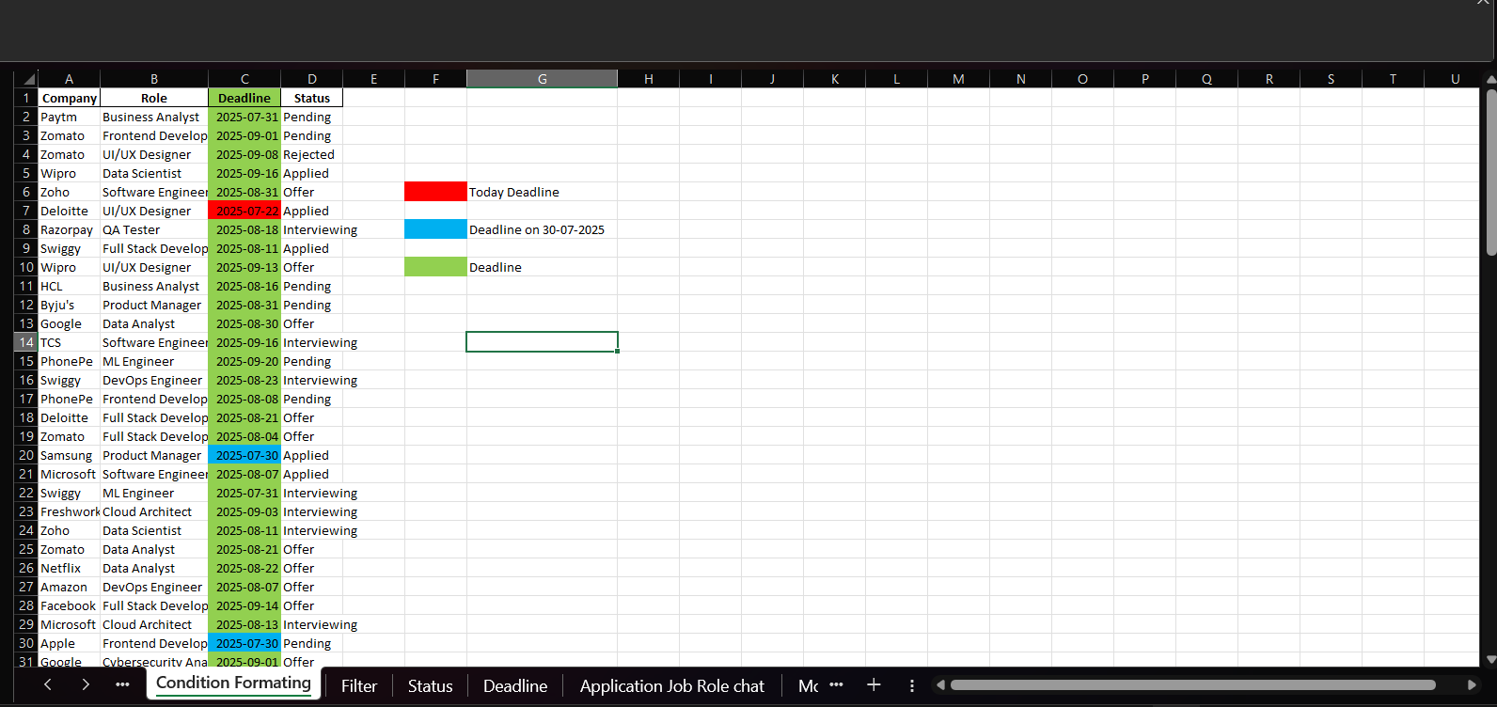
CONDITION FORMATTING

Slide 5
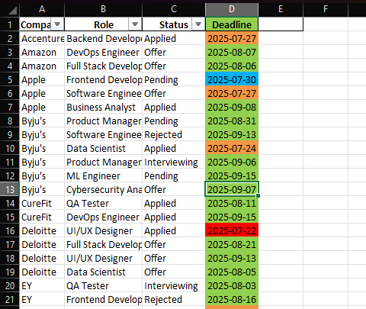
FILTERS

Slide 6
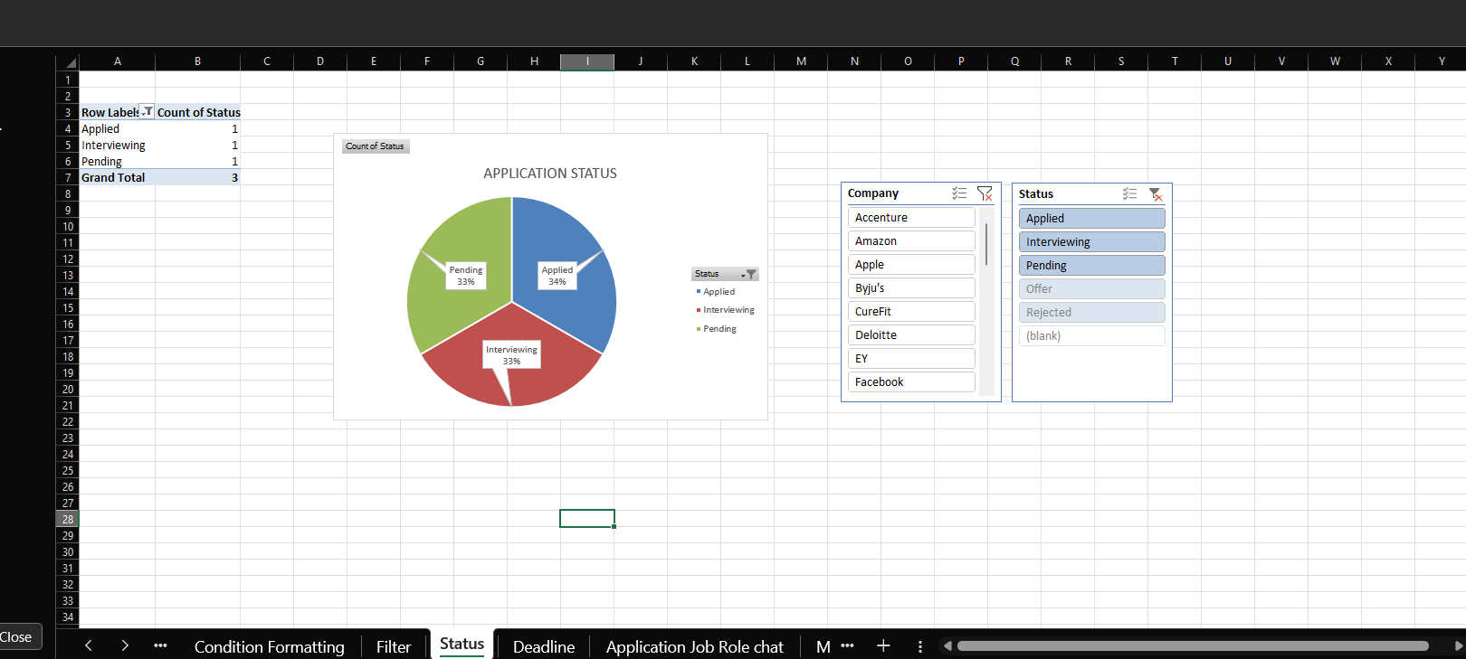
APPLICATION STATUS

Slide 7
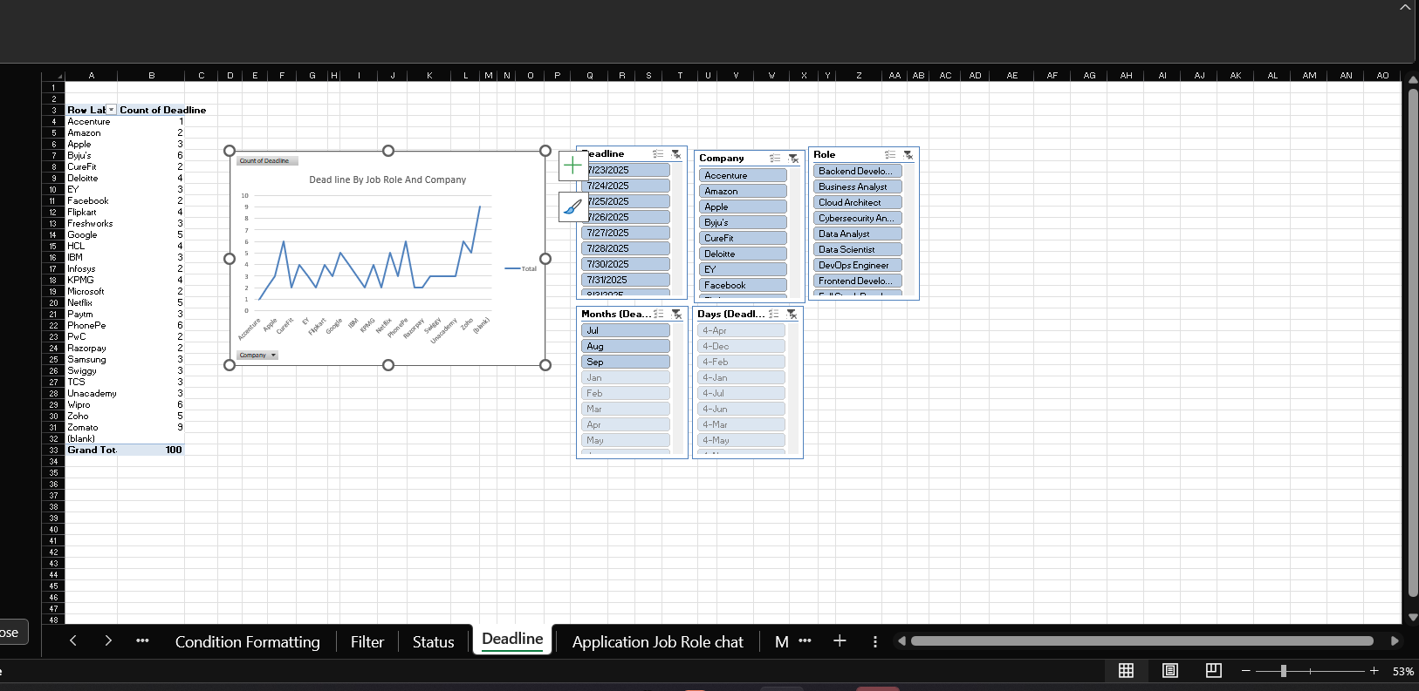
DEADLINE OF APPLICATION STATUS

Slide 8
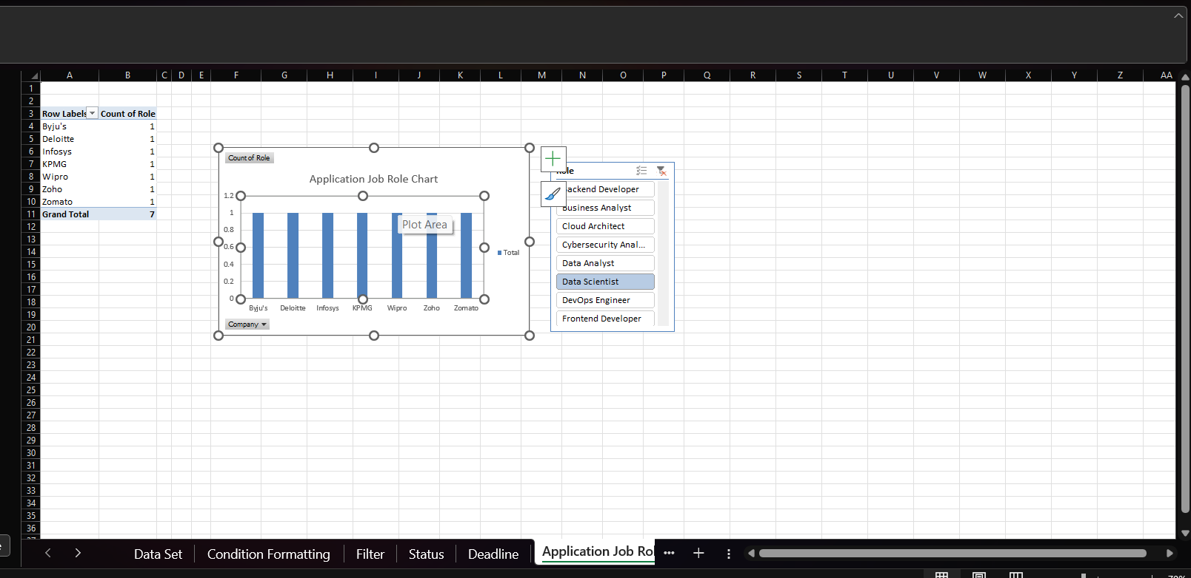
APPLICATION OF JOB ROLE COMPANY CHART

Slide 9
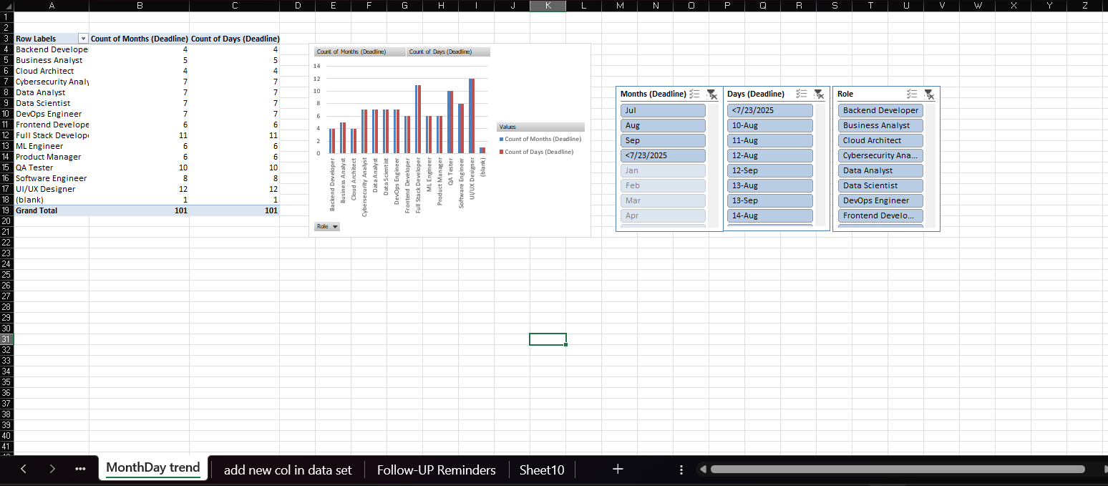
MONTH AND DAY WISE TREND CHART

Slide 10
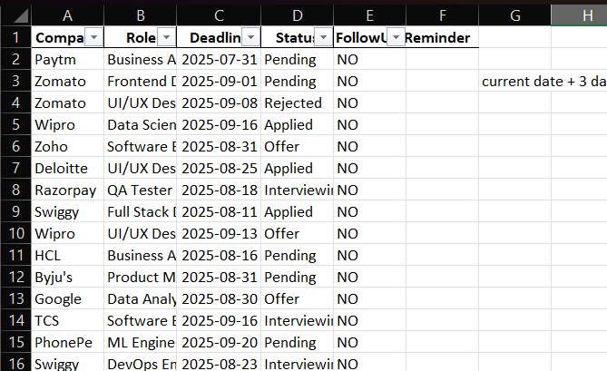
ADD NEW COLOUMN FOLLOW – UP REMINDER

Slide 11
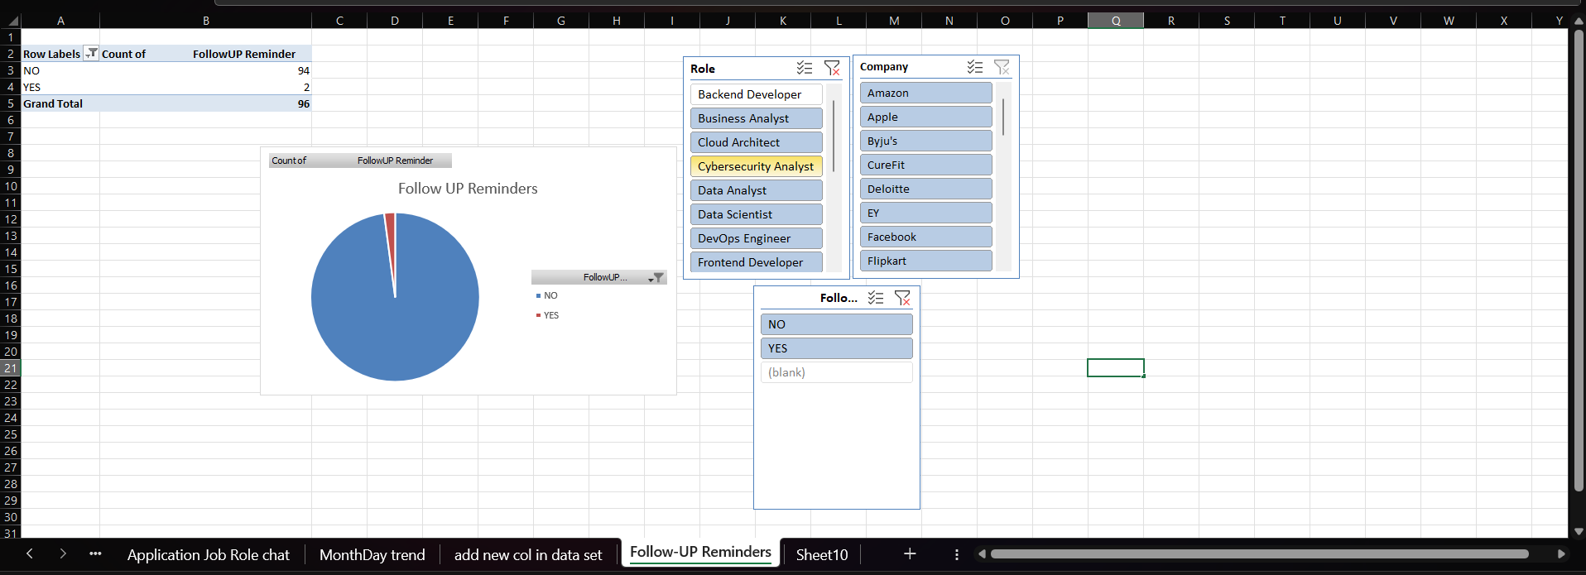
FOLLOW –UP REMINDER CHART

Slide 12
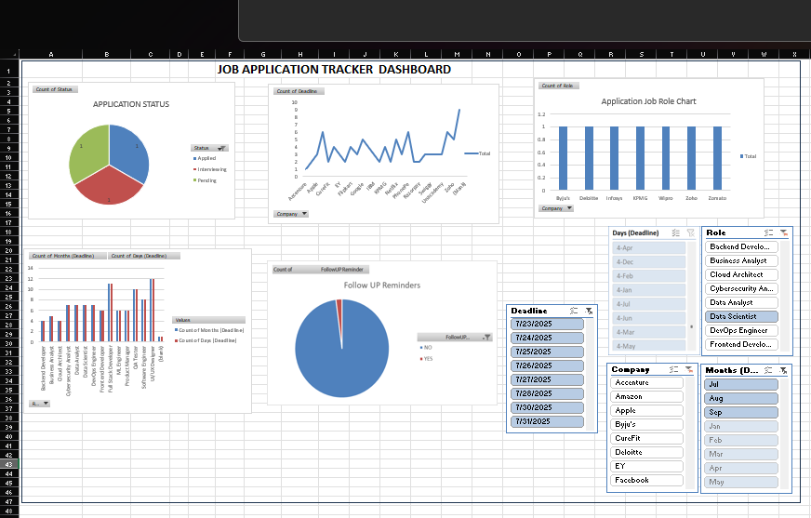
DASHBOARD

